Slide 1

SAPA Gauteng PEC 2026
MANCO and PEC Members

Slide 2
MANCO

Slide 3
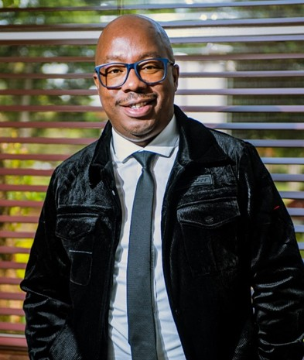
MANCO
Mathibedi-wa-Medupe
President
SAPA Gauteng • 2026

Slide 4
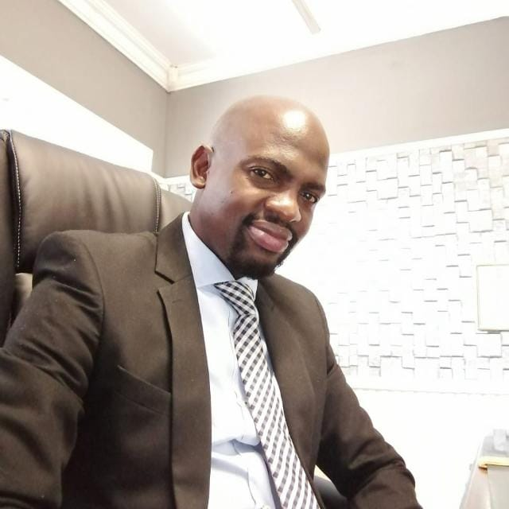
MANCO
Mr. Freddy Tlhavani
Deputy President
SAPA Gauteng • 2026

Slide 5
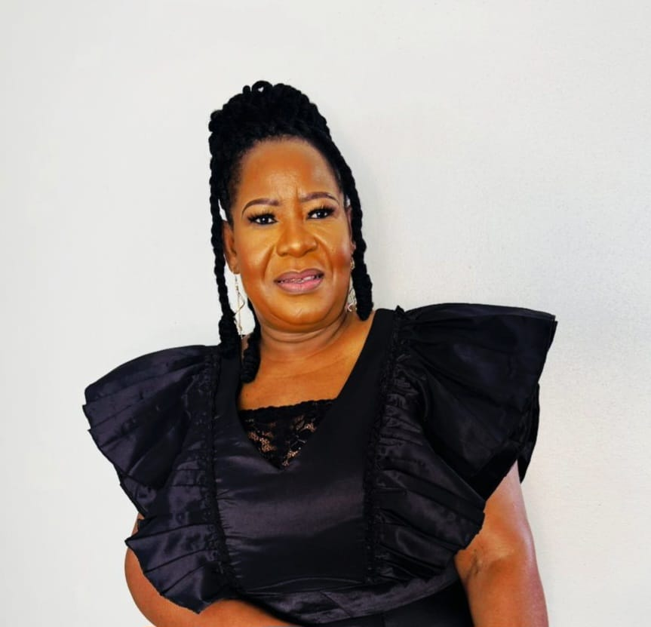
MANCO
Ms. Norah Malefo
General Secretary
SAPA Gauteng • 2026

Slide 6
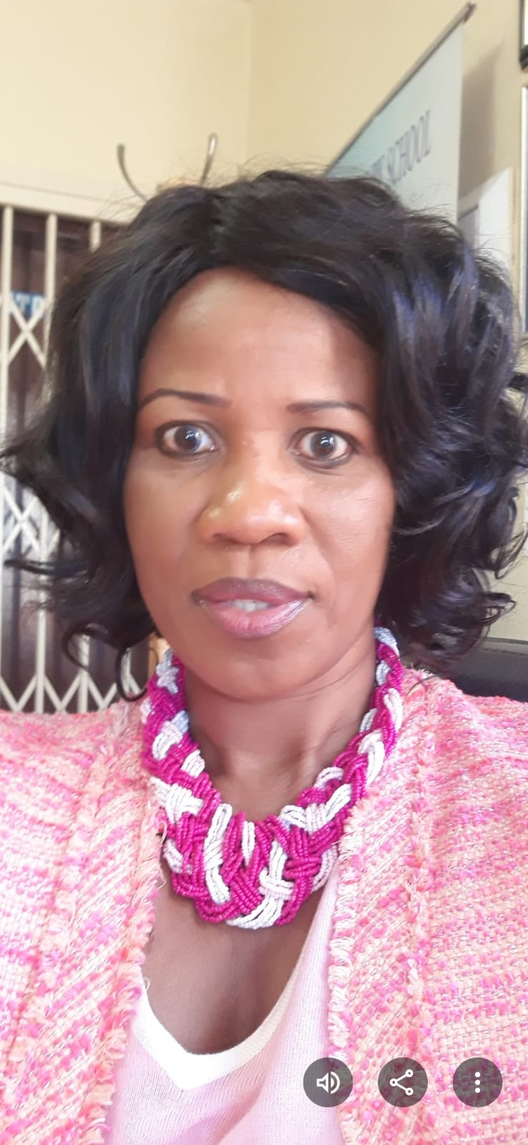
MANCO
Ms. Rose Koloko
Deputy General Secretary
SAPA Gauteng • 2026

Slide 7
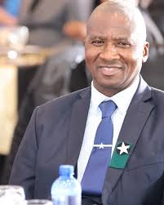
MANCO
Mr. Noko Selepe
Treasurer
SAPA Gauteng • 2026

Slide 8
PEC Members
Alphabetical by surname

Slide 9
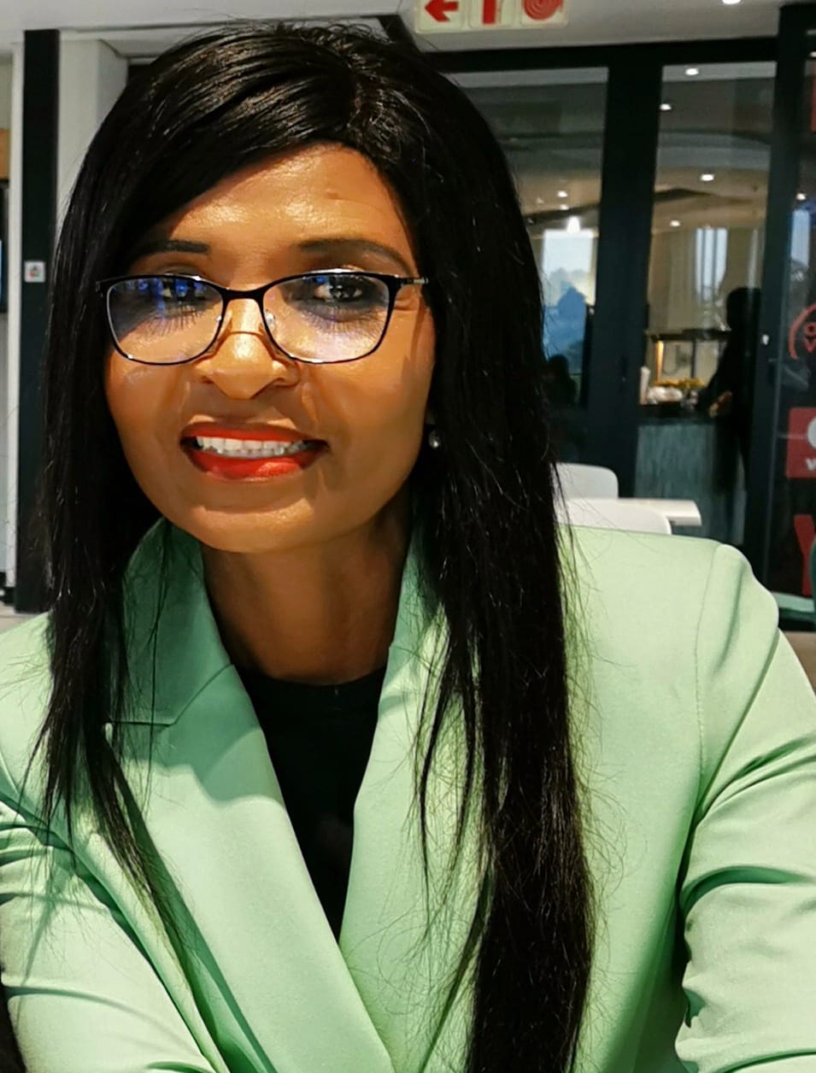
PEC
Ms. Julia Hlahle
SAPA Gauteng • 2026

Slide 10
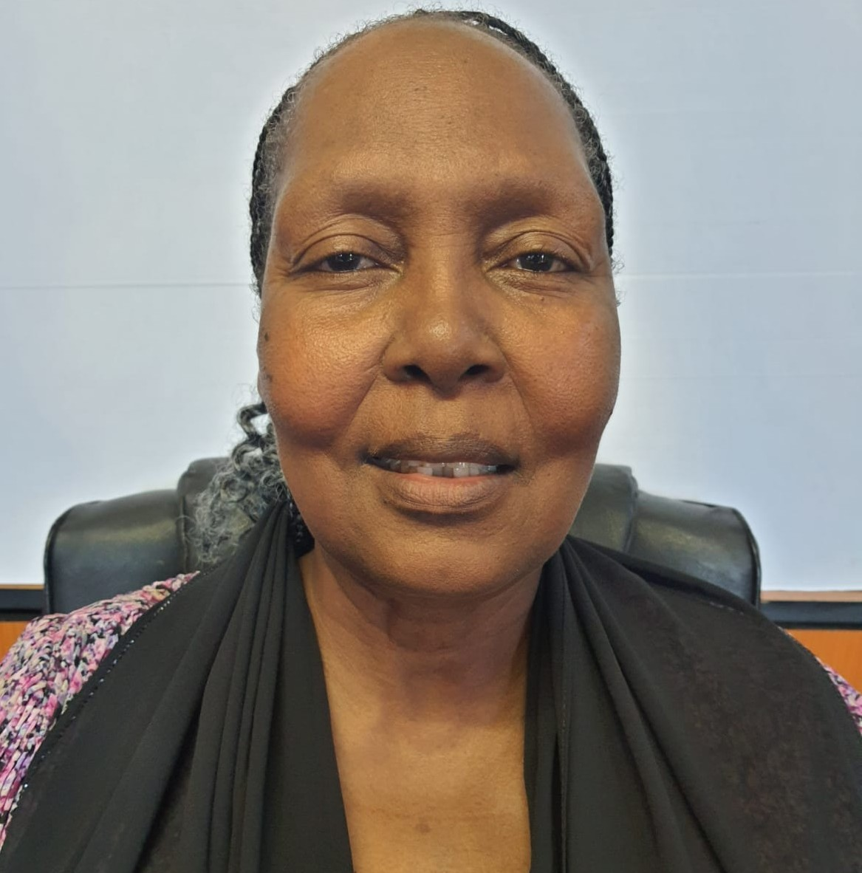
PEC
Ms. Fikile Gininda

Slide 11
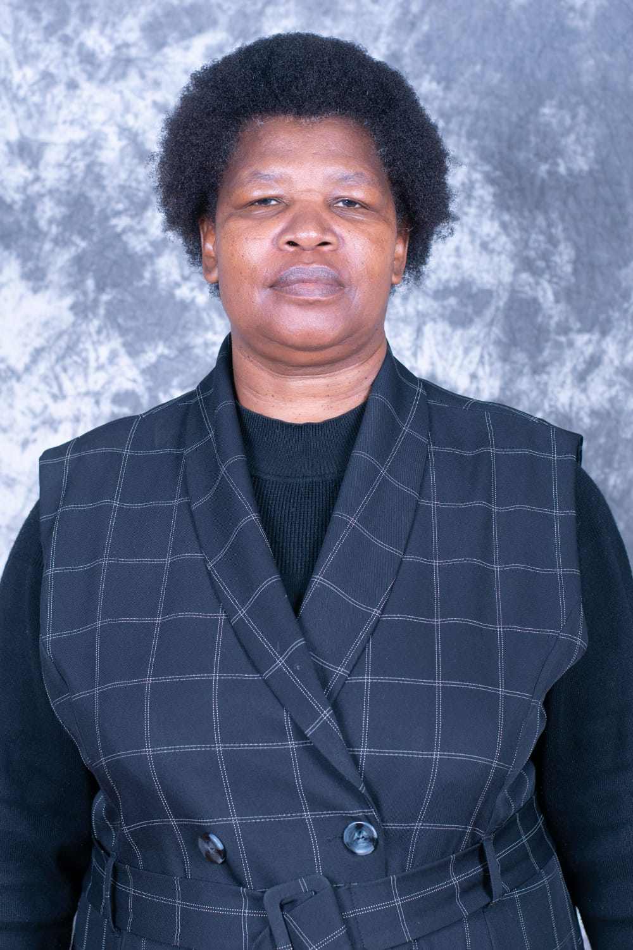
PEC
Ms. Louisa Lekalakala
SAPA Gauteng • 2026

Slide 12
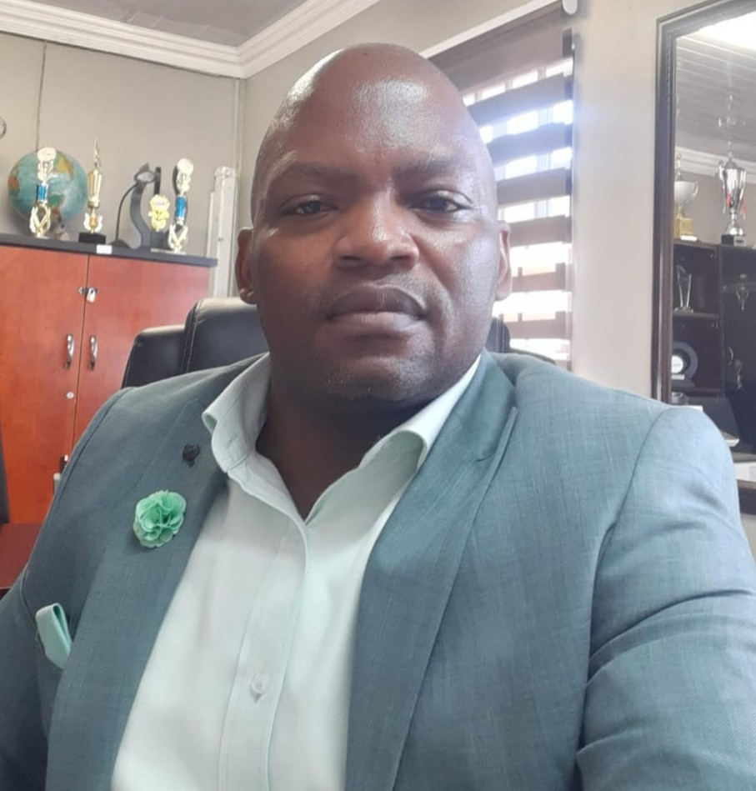
PEC
Mr. William Mabe
SAPA Gauteng • 2026

Slide 13
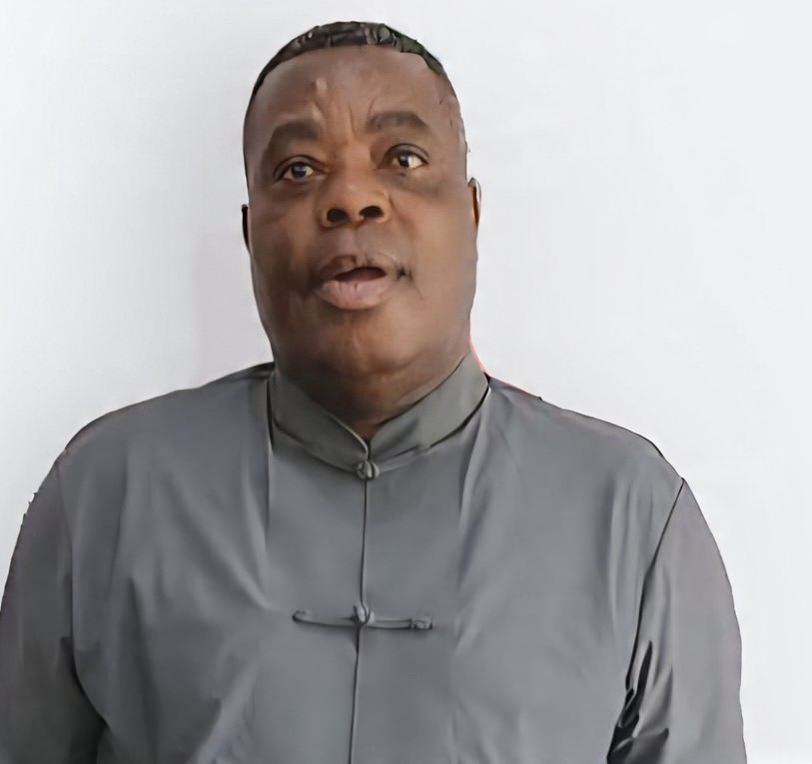
PEC
Mr. Nndivhaleni Madzena
SAPA Gauteng • 2026

Slide 14
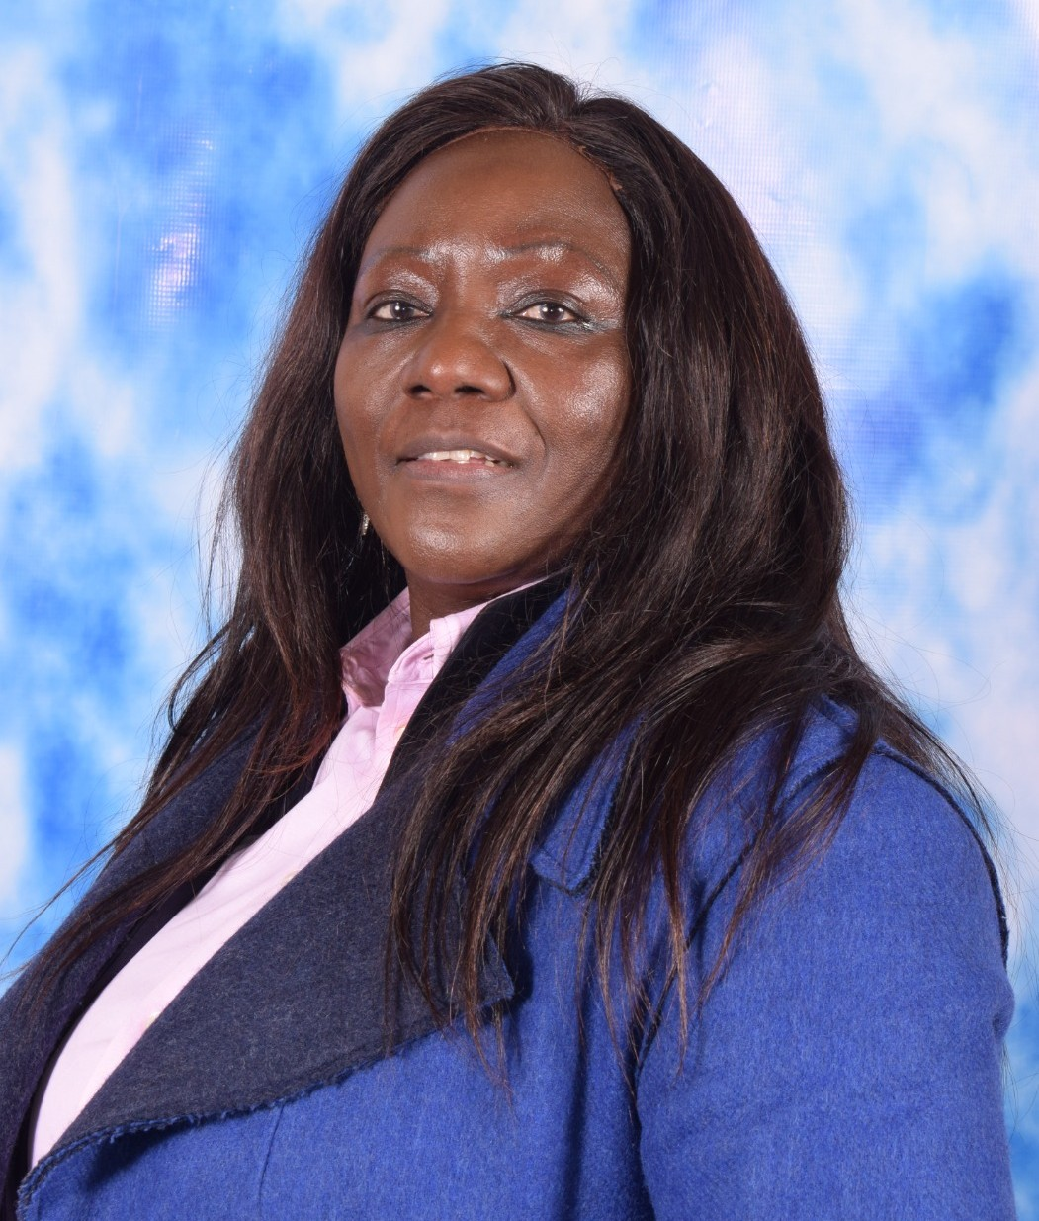
PEC
Ms. Noko Maila
SAPA Gauteng • 2026

Slide 15
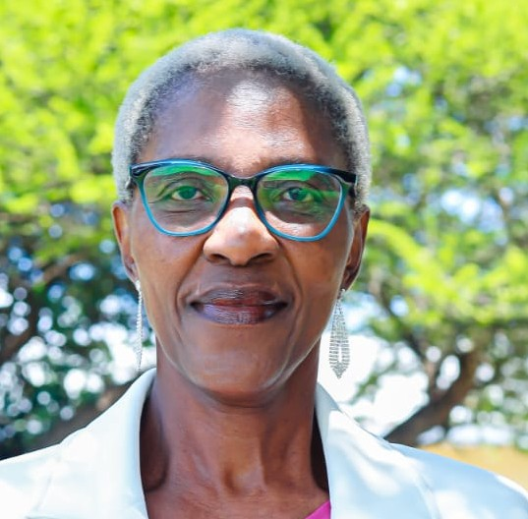
PEC
Ms. Fikile Manyaka
SAPA Gauteng • 2026

Slide 16
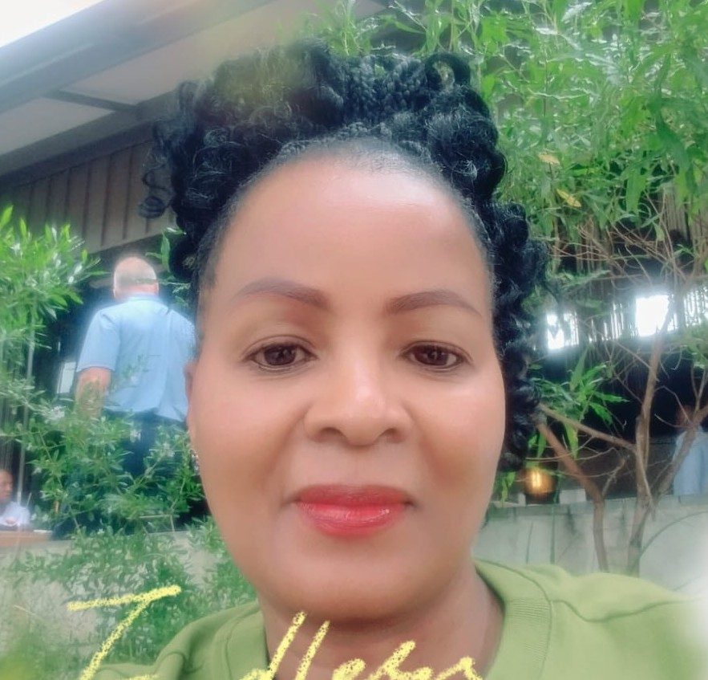
PEC
Ms. Anges Mashilo
SAPA Gauteng • 2026

Slide 17
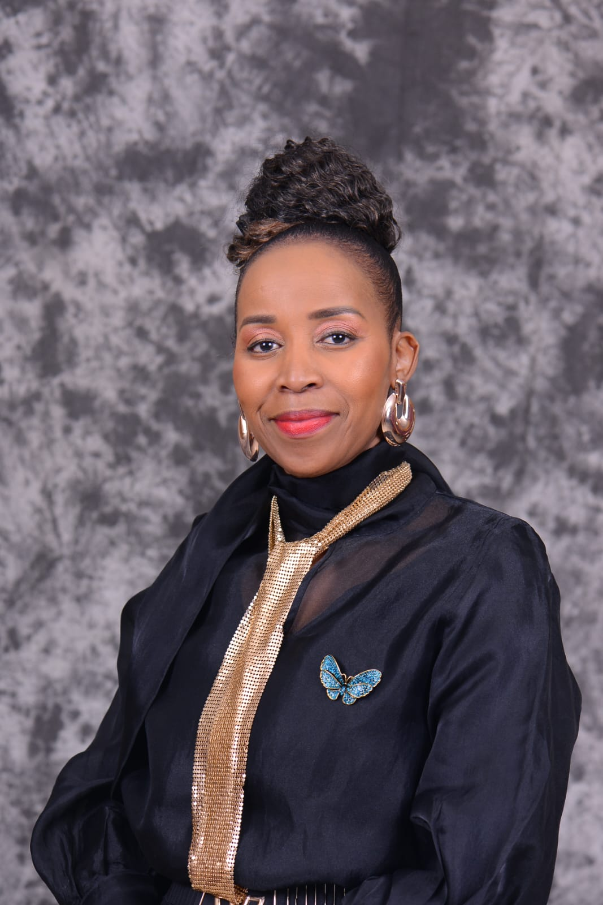
PEC
Ms. Bukelwa Mazaka
SAPA Gauteng • 2026

Slide 18
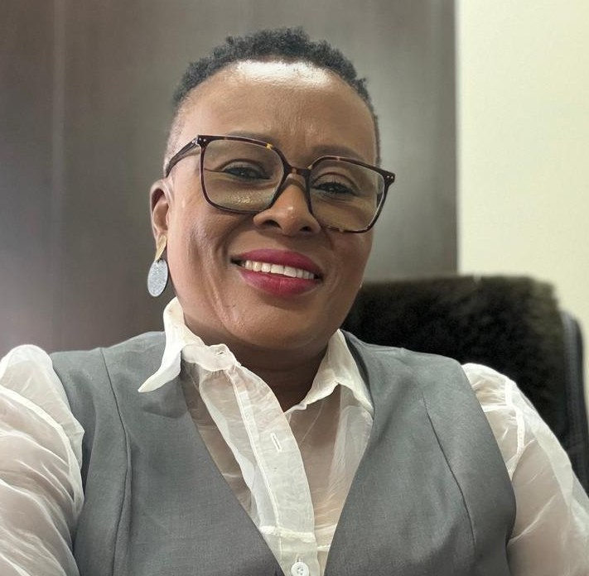
PEC
Ms. Mapula Mngomezulu
SAPA Gauteng • 2026

Slide 19
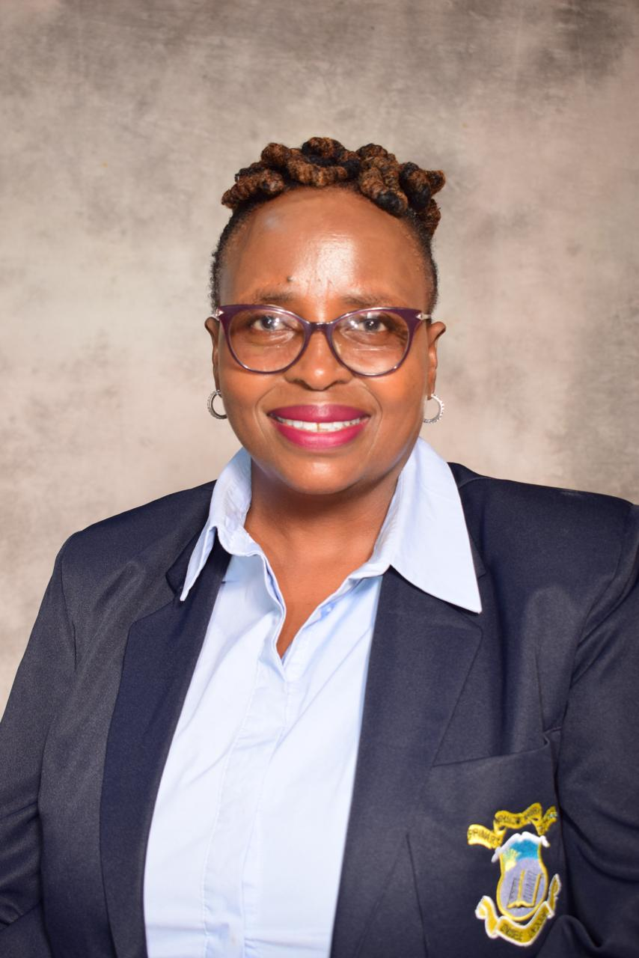
PEC
Ms. Rita Mollo
SAPA Gauteng • 2026

Slide 20
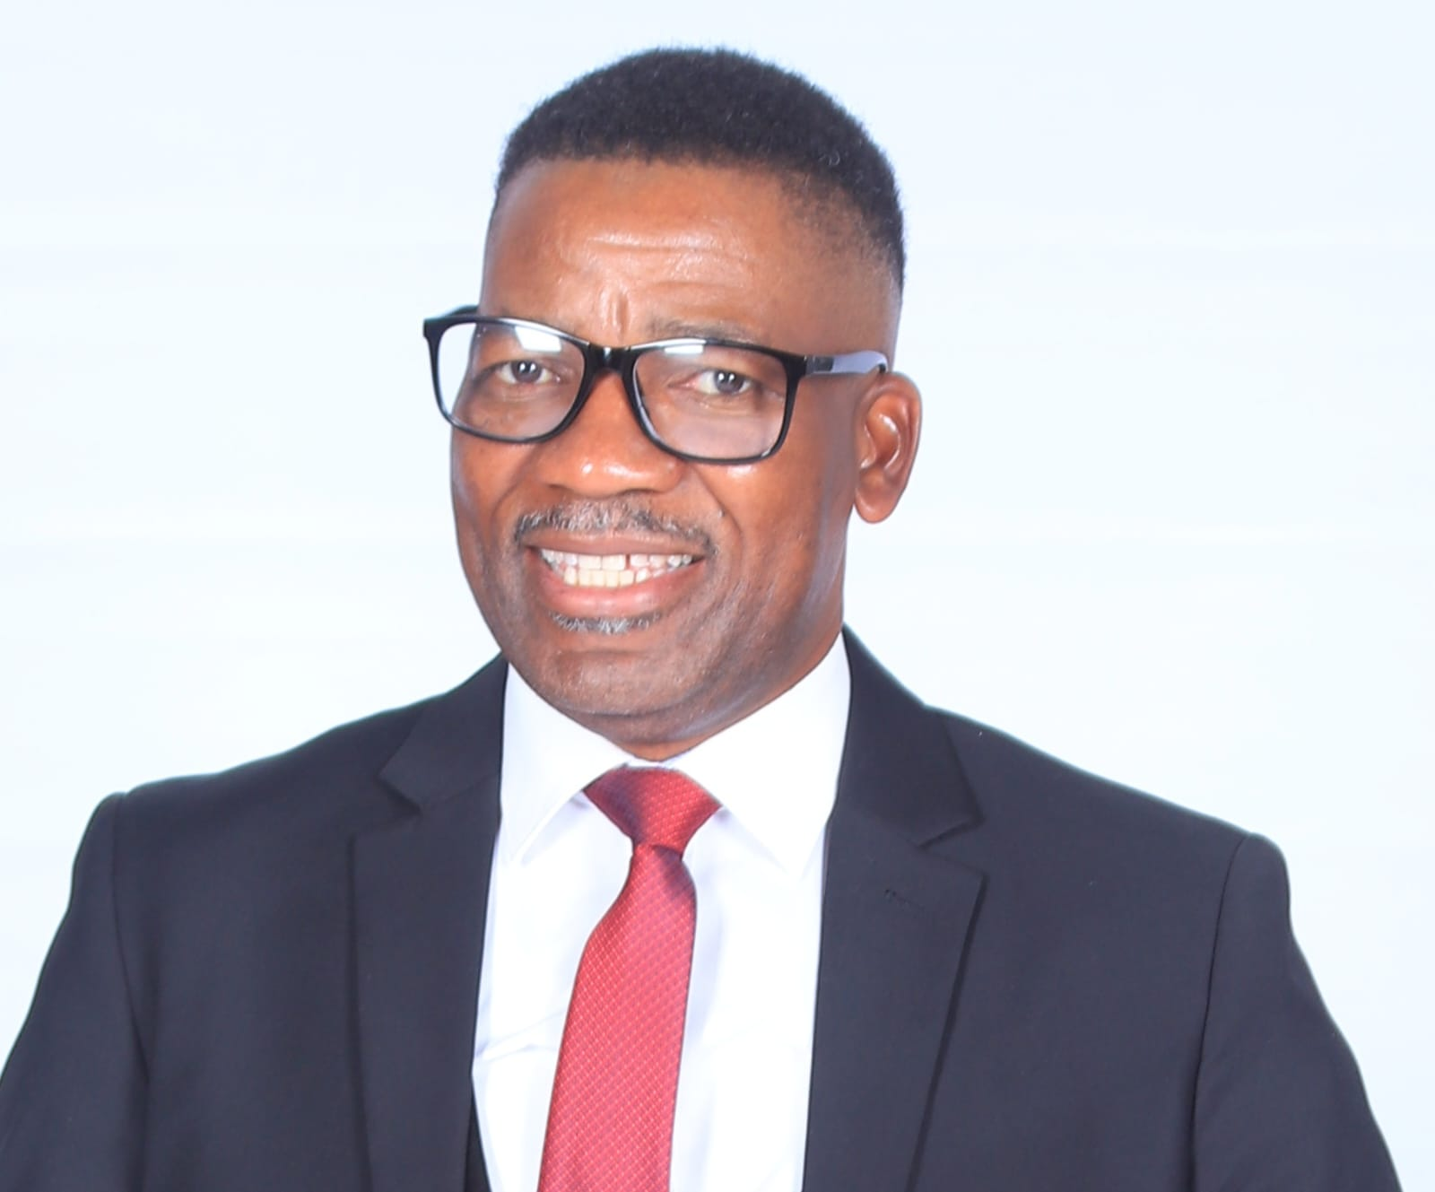
PEC
Mr. Thomas Ngobeni
SAPA Gauteng • 2026

Slide 21
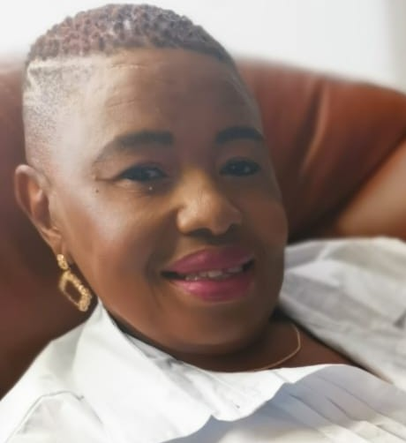
PEC
Ms. Palesa Ramaisa
SAPA Gauteng • 2026

